Slide 1
Basics in programming

Slide 2
Python modules
@property and getters/setters
In Python, getters and setters are not the same as those in other object-oriented programming languages. Basically, the main purpose of using getters and setters in object-oriented programs is to ensure data encapsulation.
Getters and Setters in python are often used when:
- We use getters & setters to add validation logic around getting and setting a value.
- To avoid direct access of a class field i.e. private variables cannot be accessed directly or modified by external user.

Slide 3
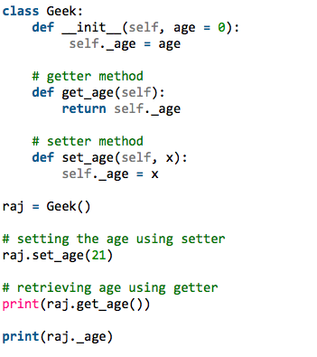
Python modules
Getters/setters
Consider our past learn way to get values from class instance

Slide 4
Python modules
Getters/setters
In Python property()is a built-in function that creates and returns a property object. A property object has three methods, getter(), setter(), and delete(). property()

Slide 5
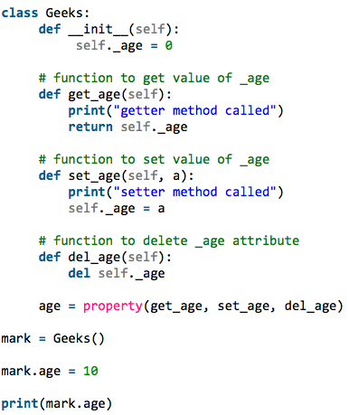
Python modules
Getters/setters
By using property we can
Define getters and setters

Slide 6
Python modules
Getters/setters
By using property we can
Define getters and setters

Slide 7
Python modules
@Property decorator
We can further go on and not define names get_temperature and set_temperature as they are unnecessary and pollute the class namespace. For this, we reuse the name temperaturewhile defining our getter and setter functions. This is how it can be done.

Slide 8
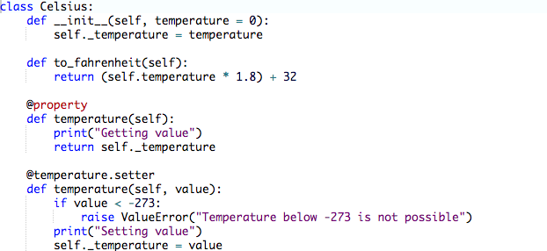
Python modules

Slide 9
Python modules
Docstring
Python Docstring is the documentation string which is string literal, and it occurs in the class, module, function or method definition, and it is written as a first statement. Docstrings are accessible from the doc attribute for any of the Python object and also with the built-in help() function can come in handy..

Slide 10
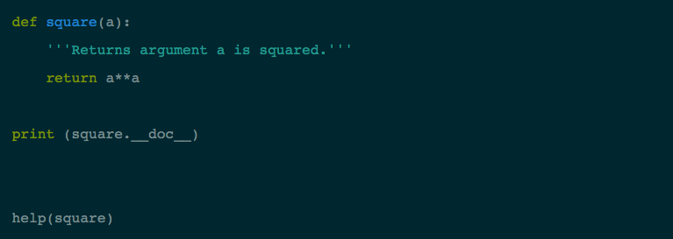
Python modules
Docstring – One line

Slide 11
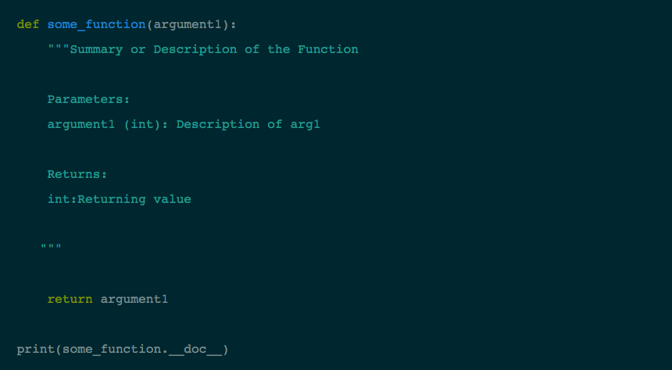
Python modules
Docstring – Multi-line

Slide 12
Python modules
Docstring –Formats
NumPy/SciPy docstrings | Combination of reStructured and GoogleDocstrings and supported by Sphinx
Pydoc | Standard documentation module for Python and supported by Sphinx
Epydoc | Render Epytext as series of HTML documents and a tool for generating API documentation for Python modules based on their Docstrings
Google Docstrings | Google's Style

Slide 13
Python modules
Docstring –Built-in Docstrings

Slide 14
Python modules
Dictionaries
Dictionary maps a set of objects (keys) to another set of objects (values). A Python dictionary is a mapping of unique keys to values.
Dictionaries are mutable, which means they can be changed.
The values that the keys point to can be any Python value.
Dictionaries are unordered, so the order that the keys are added doesn't necessarily reflect what order they may be reported back.

Slide 15
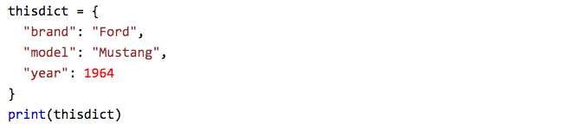
Python modules
Dictionaries

Slide 16
Python modules
Dictionaries
Access element:

Slide 17
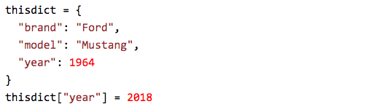
Python modules
Dictionaries
Change element:

Slide 18
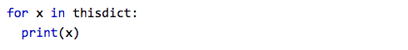
Python modules
Dictionaries
Loop trough:

Slide 19
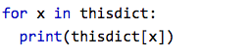
Python modules
Dictionaries
Print all values in the dictionary:

Slide 20
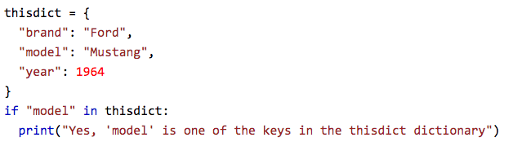
Python modules
Dictionaries
Find if key exists:

Slide 21
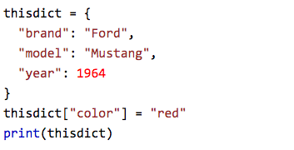
Python modules
Dictionaries
Add item:

Slide 22
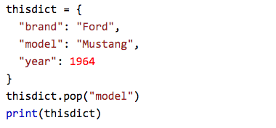
Python modules
Dictionaries
Remove item:

